Slide 1
Do Now: What is Philosophy?
Answer the Do Now question in 1 OR 2 SENTENCES.
If you really have no idea then just say that.
(5 MIN)

Slide 2
Philosphy
Greek
Philo
Sophia
LOVE
of
KNOWLEDGE
Do Now: Give your best answer to the question below in 1 OR 2 SENTENCES.
What is “knowledge”?

Slide 3
Knowledge is the awareness and understanding of particular aspects of reality. It is the clear, lucid information gained through the process of reason applied to reality.

Slide 4
”an unexamined life is not worth living” Socrates

Slide 5
SOCRATES
Lived 469 – 399 BCE
One of the founders of Western Philosophy
No writings or theories
Always asks questions about things he finds interesting
Socratic Dialectic
Executed for corrupting the Athenian youth
Plato - describes him as a irritating insect

Slide 6
SOCRATIC DIALECTIC – A method of discovering the truth.
Not a debate!
Not persuasion!
You do not assume that you have the answer or that your viewpoint is better than somebody else’s.
You are in a mutual conversation with somebody to improve your understanding and help another person improve theirs. You work together to arrive at the truth.

Slide 7
SOCRATIC DIALECTIC
A guide for arriving at the truth
Intellectual midwifery (maieutic)

Slide 8
SOCRATIC DIALECTIC
The teacher does not try to feed the students knowledge or truth.
The teacher is just a guide to arriving at certain truths
The students are no longer passive recipients of knowledge.
The students are active agents in the acquisition of knowledge.
KNOWLEDGE

Slide 9
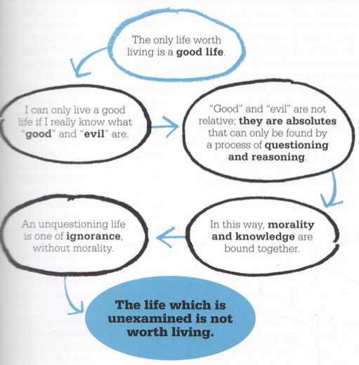

Slide 10
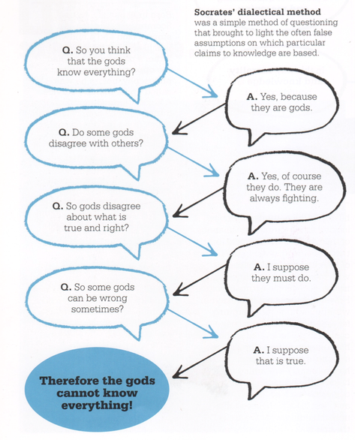
Notes:
Class on Socratic Dialectic
Explain the dialectical processes
Show the ”dialectical chain” and how it works.
For students in to groups of four
Give students a beginning question for a dialectical chain (ie: What is truth?)
Have them work singly to create a four (?) response “dialectical chain” that comes to a conclusion about the answer to the beginning question.
Students the come together in groups of 4-6 and, together, create a new, well-thought dialectical chain which draws on everybody’s work
Presentation to Class along with defense of their conclusion.

